Slide 1
Windows Installer XML
Lecturer: Ngo Huy Bien
Software Engineering Department
Faculty of Information Technology
VNUHCM - University of Science
Ho Chi Minh City, Vietnam
nhbien@fit.hcmus.edu.vn

Slide 2

Objectives
To create setup packages using WiX.
To present how to provide patches.
To present how to provide automatic updates.

Slide 3

Contents

Slide 4

References
WiX Toolset Tutorial. https://www.firegiant.com/wix/tutorial/

Slide 5
Windows Installer XML (WiX)
The Windows Installer XML (WiX) is a toolset that builds Windows installation packages from XML source code.
XML source files
WiX
MSI file
Sample.wxs
candle.exe
Sample.msi
Sample.wixobj
light.exe

Slide 6
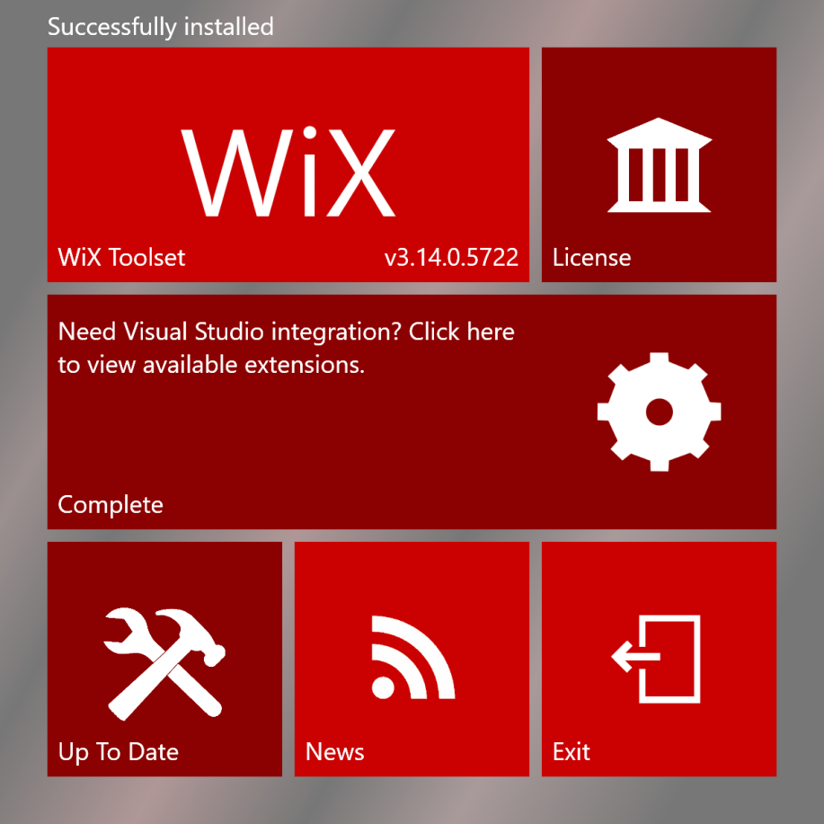
1. Install WiX
https://wixtoolset.org/releases/development/
Add C:\Program Files (x86)\WiX Toolset v3.14\bin to PATH

Slide 7
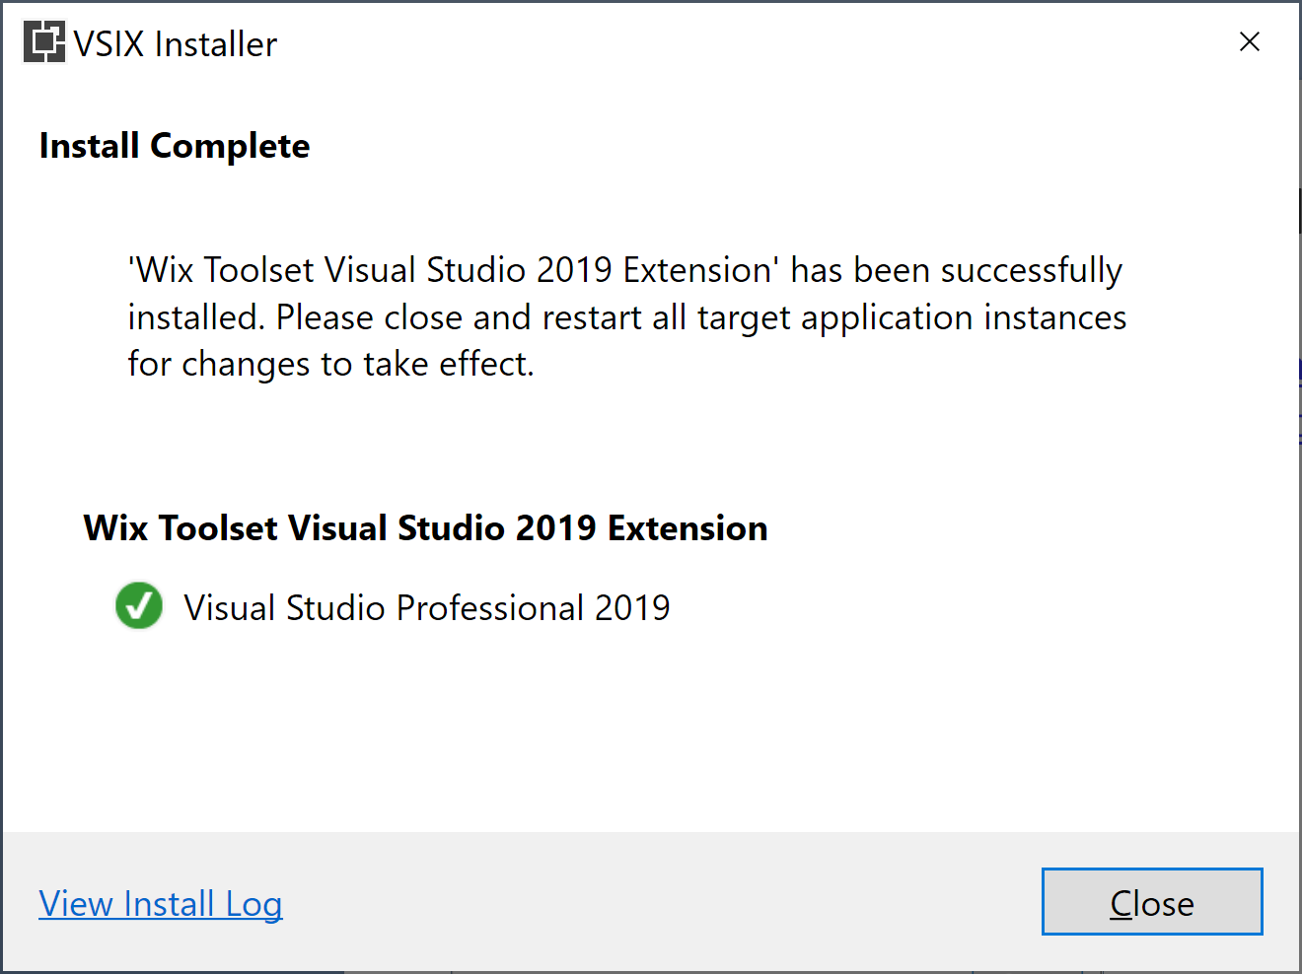
2. Install WiX Toolset Visual Studio Extension
https://marketplace.visualstudio.com/items?itemName=WixToolset.WixToolsetVisualStudio2019Extension

Slide 8
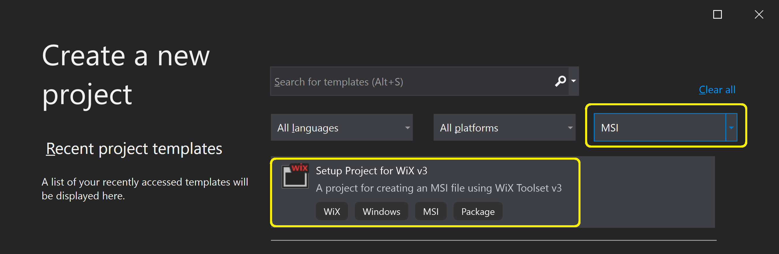
3. Create a WiX Project

Slide 9
4. Prepare IDs and Resources
https://www.guidgenerator.com/online-guid-generator.aspx
<Product UpgradeCode="ad831b42-b0bc-47f1-a93d-6c2e3b1efe09"
Id="47d6a686-700e-4f52-82d6-3faef77c3996"
<Component Guid="f4c5f23f-5ccb-4db4-b6e8-577ea9d14676"
License.rtf
Banner.bmp
Dialog.bmp
Client.exe
Client.exe.config
Business.dll
Model.dll

Slide 10
5. Prepare License.rtf
https://www.guidgenerator.com/online-guid-generator.aspx
UpgradeCode="ad831b42-b0bc-47f1-a93d-6c2e3b1efe09"
Id="47d6a686-700e-4f52-82d6-3faef77c3996"

Slide 11
6. Modify WXS File
<?xml version="1.0" encoding="utf-8"?>
<Wix xmlns="http://schemas.microsoft.com/wix/2006/wi" xmlns:util="http://schemas.microsoft.com/wix/UtilExtension" xmlns:netfx="http://schemas.microsoft.com/wix/NetFxExtension">
<!-- Change Product Id to overwrite existing version -->
<Product UpgradeCode="ad831b42-b0bc-47f1-a93d-6c2e3b1efe09" Id="47d6a686-700e-4f52-82d6-3faef77c3996" Name="Client 2.0.0" Codepage="1252" Language="1033" Version="1.0.0.0" Manufacturer="Company Name">
<Package InstallerVersion="200" Compressed="yes" Platform="x86" />
<Condition Message="You need to be an administrator to install Client 2.0.0.">
Privileged
</Condition>
...

Slide 12
7. Build the WXS File
candle Client.wxs -dHelpDirectory=HelpDocuments -dServiceURL=http://server/Service.svc -ext WixUtilExtension -out Client_2.0.0_Prod.wixobj
light Client_2.0.0_Prod.wixobj -ext WixUIExtension.dll -ext WixUtilExtension -ext WiXNetFxExtension -loc Client.wxl -out Client_Prod_2.0.0.msi

Slide 13
Basic Tasks
Creating installation package from scratch
Creating installation package using Visual Studio
Working with MSBuild
Working with Nant
Customize user interface
Customize events and actions
Working with database

Slide 14
Case Study
Registry value
License agreement
Dialog and banner
Uninstall shortcut
Product key incorporation

Slide 15
Check for .NET Framework
https://wixtoolset.org/documentation/manual/v3/howtos/redistributables_and_install_checks/check_for_dotnet.html
Add WixNetFxExtension's namespace to the WSX file
xmlns:netfx="http://schemas.microsoft.com/wix/NetFxExtension"
Add the required properties
<PropertyRef Id="NETFRAMEWORK45"/>
Use the required properties
<Show Dialog="NETMissingDialog" After="AppSearch">
<![CDATA[(NOT Installed) AND (NOT NETFRAMEWORK45)]]>
</Show>

Slide 16
Custom Action
Adding the custom actions:
<CustomAction Id="RegisterAddin" Directory="INSTALLDIR" ExeCommand='regsvr32.exe /s "[INSTALLDIR]addin.dll"' Return="check">
</CustomAction>
<CustomAction Id="UnregisterAddin" Directory="INSTALLDIR" ExeCommand='regsvr32.exe /s /u "[INSTALLDIR]addin.dll"'>
</CustomAction>
Defining the execution "sequence":
<InstallExecuteSequence>
<Custom Action=" RegisterAddin" After="InstallFinalize">NOT Installed</Custom>
<Custom Action="UnregisterAddin" Before="InstallInitialize">Installed</Custom>
</InstallExecuteSequence>

Slide 17
Auto Update
https://stackoverflow.com/questions/7395609/what-is-the-best-way-to-auto-update-a-windows-application
An updater application which checks for updates regularly. If an update is found it should install it automatically.
Some updaters use services. For automated updates this isn't a real solution because service installation needs Administrator privileges. So your install process and subsequent updates would show elevation prompts.
Another approach is to use a per-user Updater application. It doesn't require any elevation and it can be installed in the application folder. This type of updater can run either as a scheduled task or from within your application (execute it when your application starts).
In both scenarios you need to consider that the Updater may need to update itself. So the process which performs the update must be a temporary process (for example a temporary copy of the updater application). It also should run without elevation. This is why a service is not such a good idea. It would need to stop itself before the update, use a temporary process which handles the update and start again when finished.
Other things to consider are:
permissions issues (if the update process needs any privileges or elevation)
download locations
update detection mechanism (how the Updater detects if a new version should be installed or not)

Slide 18
The Updates
A common misconception is that updates should be the application files (like the main application EXE). This is rarely the case because an update may need to overwrite more than just a file.
Most updates are installation packages (MSI for example) or patches (MSP). This is the best approach because they handle the entire update logic:
detect running applications
update resources
update the product information (shortcuts, Programs and Features applet in Control Panel etc.)
Installation packages also simplify the Updater application. With this type of updates the Updater needs only to detect available updates, download them and execute them.
Updates works in two ways:
major upgrades: the old version is completely uninstalled before the new one is installed
minor upgrades: the old version is patched

Slide 19
Update Distribution
After you decide on an Updater and some update packages, you also need a distribution mechanism:
a way to inform the updater that updates are available (for example an updates information file on your server)
a way to detect if an update is installed or not (so it's installed only once)
Usually the client updater application is platform specific. So you need a different updater for each platform. The server part is the same for all platforms.

Slide 20

Thank You & See You Again

